Slide 1
Visual Design Principles
What does this have to do with our topic?

Slide 2
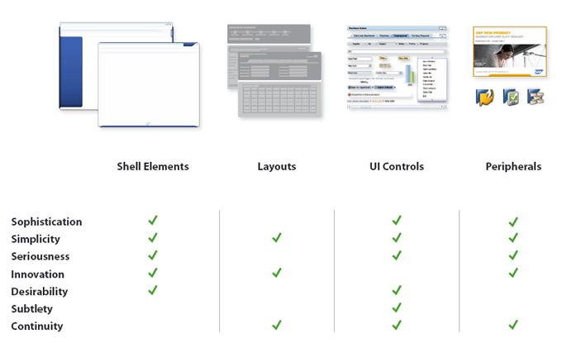
15. Visual Design Principles
Beginning to think
about
how it looks

Slide 3

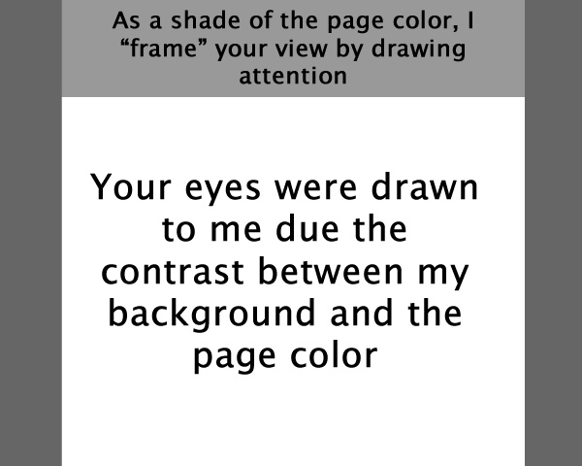
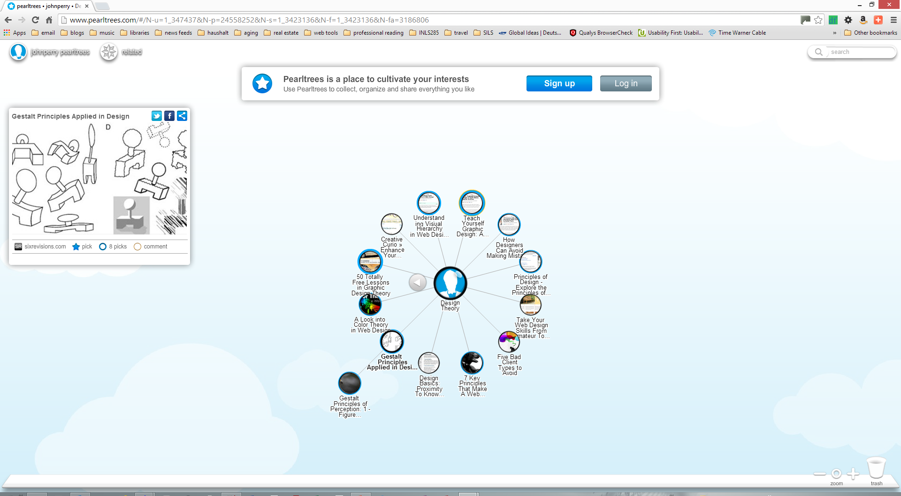
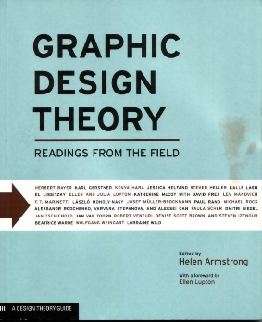
Let’s consider a bit of theory before delving deeper

Slide 4
Some principles of design
Balance
Proportion
Rhythm
Emphasis
Unity

Slide 5
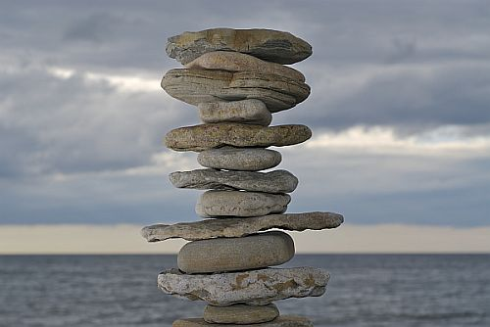
Some principles of design
balance
it is a reconciliation of opposing forces in a composition that results in visual stability
Balance is the concept of visual equilibrium,
and relates to our physical sense of balance.
Proportion
Rhythm
Emphasis
Unity

Slide 6
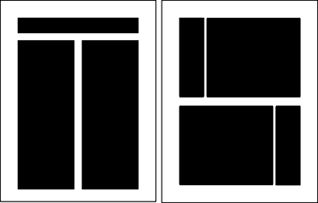
Some principles of design
balance
symmetrical balance can be described as having equal "weight" on equal sides of a centrally placed fulcrum
Balance is the concept of visual equilibrium,
and relates to our physical sense of balance.
Proportion
Rhythm
Emphasis
Unity

Slide 7
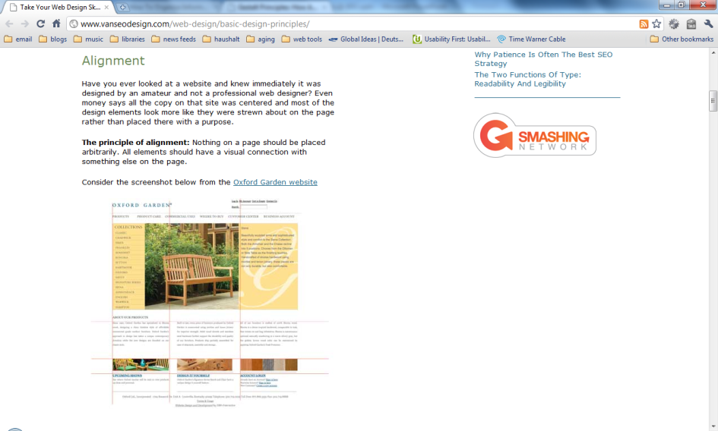
Some principles of design
balance
symmetrical balance can be described as having equal "weight" on equal sides of a centrally placed fulcrum
Balance is the concept of visual equilibrium,
and relates to our physical sense of balance.
Proportion
Rhythm
Emphasis
Unity

Slide 8
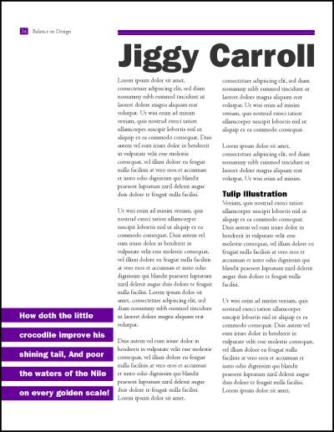
Some principles of design
balance
that will
allow objects of varying visual weight to balance one another around a fulcrum point
Balance is the concept of visual equilibrium,
and relates to our physical sense of balance.
Proportion
Rhythm
Emphasis
Unity

Slide 9
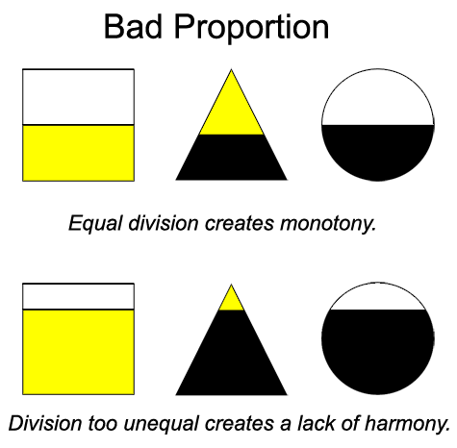
Some principles of design
proportion
the issue is the relationship between objects, or parts, of a whole
Balance
Proportion refers to the relative size
and scale of the various elements in a design.
Rhythm
Emphasis
Unity

Slide 10
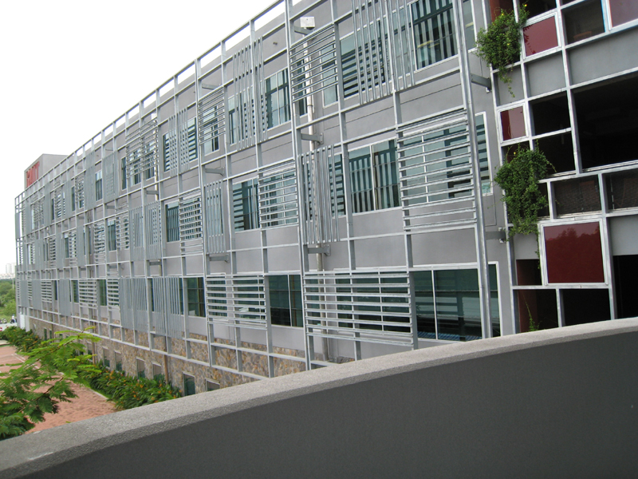
Some principles of design
proportion
the issue is the relationship between objects, or parts, of a whole
Balance
Proportion refers to the relative size
and scale of the various elements in a design.
Rhythm
Emphasis
Unity

Slide 11
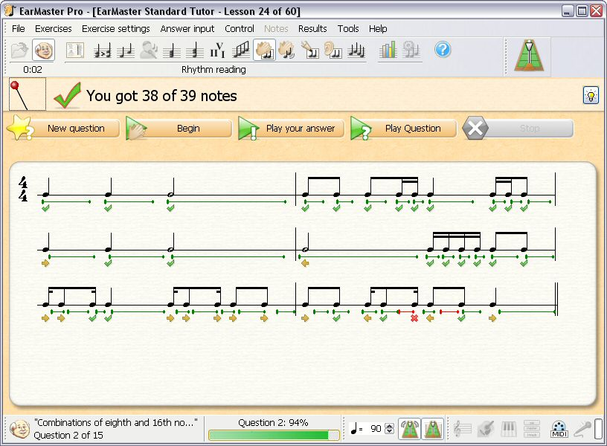
Some principles of design
rhythm
visual rhythm may be best understood by relating it to rhythm in sound
Balance
Proportion
Rhythm
  an easy, connected path along which the eye follows a regular arrangement of motifs
  The presence of rhythm creates predictability and order in a composition.
Emphasis
Unity

Slide 12
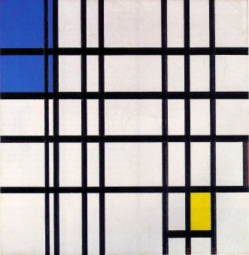
Some principles of design
rhythm
visual rhythm may be best understood by relating it to rhythm in sound
Balance
Proportion
Rhythm
  an easy, connected path along which the eye follows a regular arrangement of motifs
  The presence of rhythm creates predictability and order in a composition.
Emphasis
Unity

Slide 13
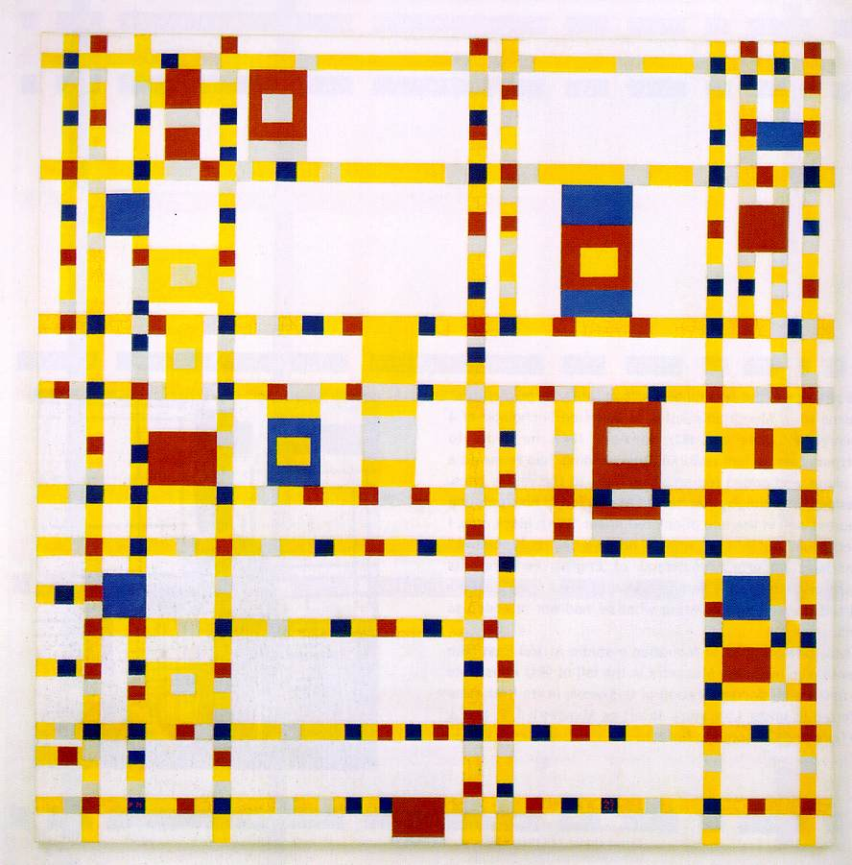
Some principles of design
rhythm
visual rhythm may be best understood by relating it to rhythm in sound
Balance
Proportion
Rhythm
  an easy, connected path along which the eye follows a regular arrangement of motifs
  The presence of rhythm creates predictability and order in a composition.
Emphasis
Unity

Slide 14
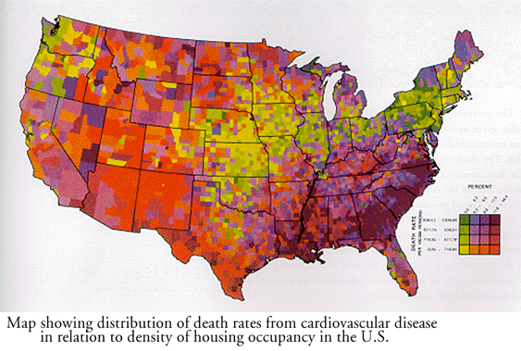
Some principles of design
emphasis
use emphasis to call attention to
something, using repetition or
contrast
Balance
Proportion
Rhythm
Emphasis
  marks the locations in a composition which most strongly draw the viewers attention
Unity

Slide 15
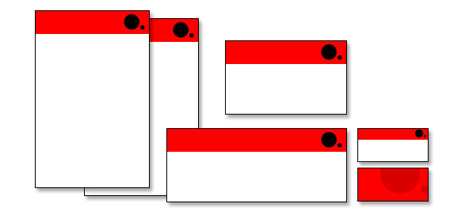
Some principles of design
emphasis
use emphasis to call attention to
something, using repetition or
contrast
Balance
Proportion
Rhythm
Emphasis
  marks the locations in a composition which most strongly draw the viewers attention
Unity

Slide 16
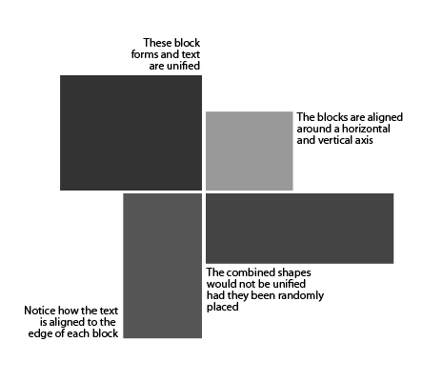
Some principles of design
unity
pattern, form, color, concept
Balance
Proportion
Rhythm
Emphasis
Unity
  coherence of the whole, the sense that all of the parts are working together to achieve a common result; a harmony of all the parts

Slide 17
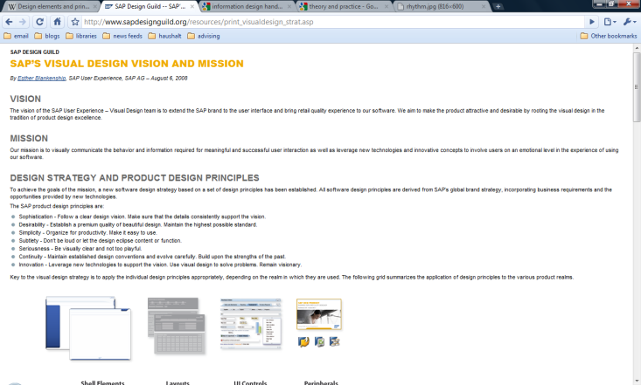
Some principles of design
unity
pattern, form, color, concept
Balance
Proportion
Rhythm
Emphasis
Unity
  coherence of the whole, the sense that all of the parts are working together to achieve a common result; a harmony of all the parts

Slide 18
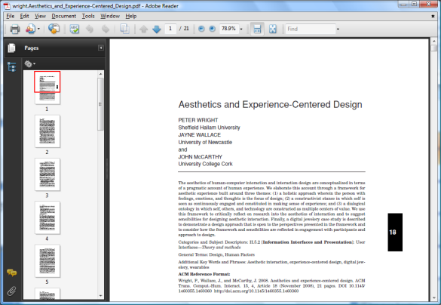
Aesthetics and Experience-Centered Design
a holistic approach
The Sensual Thread
The Emotional Thread
The Spatio-Temporal Thread
The Compositional Thread

Slide 19
Aesthetics and Experience-Centered Design
continuous engagement
and sense making
Anticipating
Connecting
Interpreting
Reflecting
Recounting
Appropriating

Slide 20
Aesthetics and Experience-Centered Design
continuous engagement
and sense making
a pragmatist understanding of felt life can be used within a process of design and making, both as a way of understanding and talking about this process, but also as a way of seeing within this process that allows designers and makers to put empathy, felt life, and human experience at the center of the design process.

Slide 21
Theoretical underpinnings
How the brain sees
Gestalt theory
Understanding?
Notes:
Starting with the theoretical basis, we want to explore three sub-topics.

Slide 22
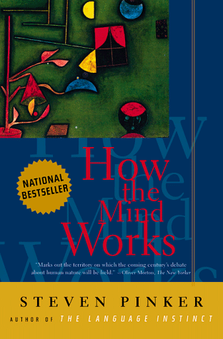
How the brain sees
vision
a process that produces from images of the external world
a description that is useful to the viewer
and not cluttered with irrelevant information
Notes:
Pinker, pp. 211-298.
Discusses stereo vision; lighting, shade, and shape; frames of reference; and mental images. Considers how we recognize shapes as things. If mental images are "seeing inside the brain," we need to recognize that there are limitations.

Slide 23
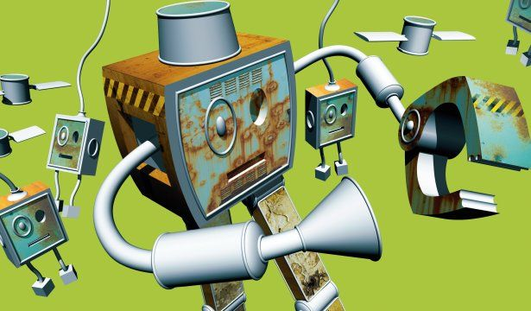
How the brain sees - vision
we see
at best, ours is an abstract appreciation of our world
what's in front of us,
not what's all around us
surface, not volume
in 2D, not 3D
we see in perspective
Notes:
Pinker, pp. 211-298.
Discusses stereo vision; lighting, shade, and shape; frames of reference; and mental images. Considers how we recognize shapes as things. If mental images are "seeing inside the brain," we need to recognize that there are limitations.

Slide 24
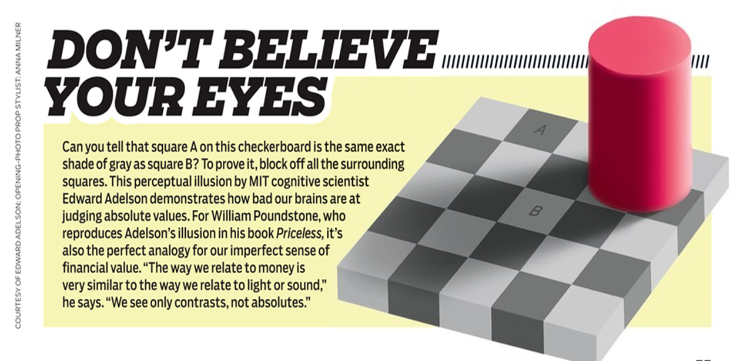
How the brain sees - vision
we see
at best, ours is an abstract appreciation of our world
what's in front of us,
not what's all around us
Notes:
Pinker, pp. 211-298.
Discusses stereo vision; lighting, shade, and shape; frames of reference; and mental images. Considers how we recognize shapes as things. If mental images are "seeing inside the brain," we need to recognize that there are limitations.

Slide 25
How the brain sees - vision
we see
at best, ours is an abstract appreciation of our world
what's in front of us,
not what's all around us
Don’t believe your eyes
Notes:
Pinker, pp. 211-298.
Discusses stereo vision; lighting, shade, and shape; frames of reference; and mental images. Considers how we recognize shapes as things. If mental images are "seeing inside the brain," we need to recognize that there are limitations.

Slide 26
How the brain sees - vision
we see
at best, ours is an abstract appreciation of our world
what's in front of us,
not what's all around us
Don’t believe your eyes
Notes:
Pinker, pp. 211-298.
Discusses stereo vision; lighting, shade, and shape; frames of reference; and mental images. Considers how we recognize shapes as things. If mental images are "seeing inside the brain," we need to recognize that there are limitations.

Slide 27
How the brain sees - vision
we see
at best, ours is an abstract appreciation of our world
what's in front of us,
not what's all around us
Don’t believe your eyes
Notes:
Pinker, pp. 211-298.
Discusses stereo vision; lighting, shade, and shape; frames of reference; and mental images. Considers how we recognize shapes as things. If mental images are "seeing inside the brain," we need to recognize that there are limitations.

Slide 28
How the brain sees - vision
we don't see
at best, ours is an abstract appreciation of our world
discrete objects
rather we see surfaces and the boundaries between them
Notes:
Pinker, pp. 211-298.
Discusses stereo vision; lighting, shade, and shape; frames of reference; and mental images. Considers how we recognize shapes as things. If mental images are "seeing inside the brain," we need to recognize that there are limitations.

Slide 29
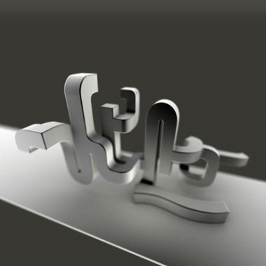
How the brain sees - vision
mental images are not complete
recognition of shapes as things are limited
they are fragmentary parts of a complete image
rather we see surfaces and the boundaries between them
Notes:
Pinker, pp. 211-298.
Discusses stereo vision; lighting, shade, and shape; frames of reference; and mental images. Considers how we recognize shapes as things. If mental images are "seeing inside the brain," we need to recognize that there are limitations.

Slide 30
How the brain sees - vision
we use conceptual knowledge of our world to categorize mental images
recognition of shapes as things are limited
not the characteristics of the image itself
images are ambiguous
Notes:
Pinker, pp. 211-298.
Discusses stereo vision; lighting, shade, and shape; frames of reference; and mental images. Considers how we recognize shapes as things. If mental images are "seeing inside the brain," we need to recognize that there are limitations.

Slide 31

Constructing meaning for what it sees
rules for visual construction
One school of thought holds that
we create a visual experience
of objects that we see
in a phenomenal sense
Notes:
We convert those ambiguous images into objects that have meaning by applying rules.
Hoffman, pp. 47-77
Describes how one creates a visual experience of objects that one sees in a phenomenal sense. Hoffman accepts the ideas of the perception theorist, J.J. Gibson, ideas that we will discuss shortly.
Discusses the actions of the eye and the brain and how their physical properties, as modified through "rules," construct what you can see as well as restrict what you can construct and what you can do with your constructions

Slide 32
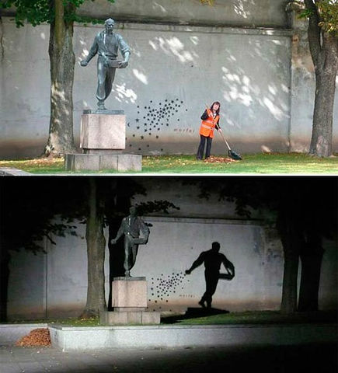
Constructing meaning for what it sees
physical properties
of the eye and the brain
modified through "rules"
construct what you can see
and restrict what you can construct
Notes:
We convert those ambiguous images into objects that have meaning by applying rules.
Hoffman, pp. 47-77
Describes how one creates a visual experience of objects that one sees in a phenomenal sense. Hoffman accepts the ideas of the perception theorist, J.J. Gibson, ideas that we will discuss shortly.
Discusses the actions of the eye and the brain and how their physical properties, as modified through "rules," construct what you can see as well as restrict what you can construct and what you can do with your constructions

Slide 33
Constructing meaning for what it sees
physical properties
of the eye and the brain
modified through "rules"
construct what you can see
and restrict what you can construct
Notes:
We convert those ambiguous images into objects that have meaning by applying rules.
Hoffman, pp. 47-77
Describes how one creates a visual experience of objects that one sees in a phenomenal sense. Hoffman accepts the ideas of the perception theorist, J.J. Gibson, ideas that we will discuss shortly.
Discusses the actions of the eye and the brain and how their physical properties, as modified through "rules," construct what you can see as well as restrict what you can construct and what you can do with your constructions

Slide 34
Constructing meaning for what it sees
but what kind of “rules” are applied?
Notes:
We convert those ambiguous images into objects that have meaning by applying rules.
Hoffman, pp. 47-77
Describes how one creates a visual experience of objects that one sees in a phenomenal sense. Hoffman accepts the ideas of the perception theorist, J.J. Gibson, ideas that we will discuss shortly.
Discusses the actions of the eye and the brain and how their physical properties, as modified through "rules," construct what you can see as well as restrict what you can construct and what you can do with your constructions

Slide 35
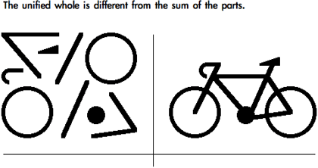
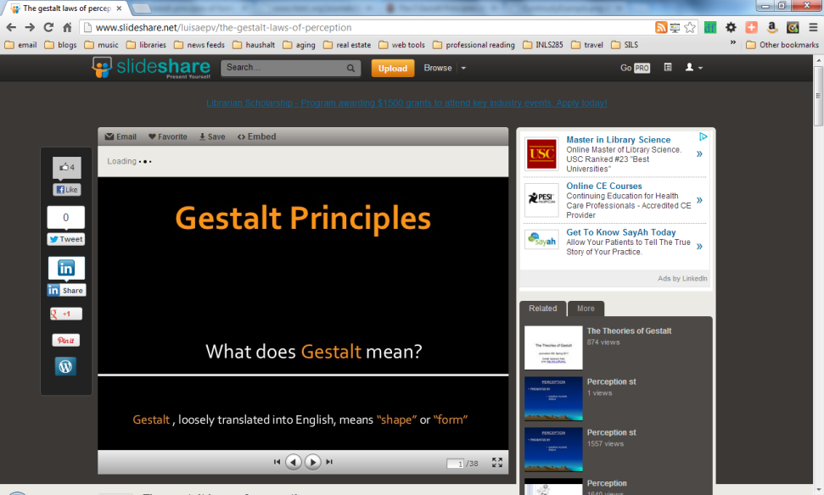
Gestalt Theory
Gestalt Principles
proximity
similarity
continuity
symmetry
closure
relative size
figure & ground
Notes:
The Gestalt (in English, form, pattern, shape, or character) School of Psychology investigated how we perceive form and produced a clear description of basic perceptual phenomena. Their findings are capsulated into seven laws for which we can extract relevant design principles.
In the next 7 slides, we’ll consider each one by itself.
Horn, pp. 75-76.
Ware, pp. 203-213.

Slide 36
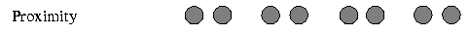

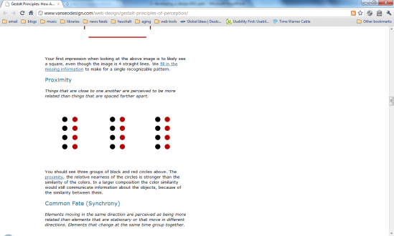
Gestalt Theory
Gestalt Proximity Principle
we tend to perceive things
that are close together
as being parts of a coherent group
the simplest
and most powerful way
to emphasize the relationship between objects is to place them in proximity
proximity
similarity
continuity
symmetry
closure
relative size
figure & ground
196
Notes:
if they look like they belong together, we see them as a group

Slide 37
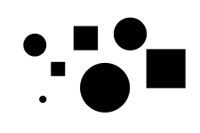
Gestalt Theory
Gestalt Similarity Principle
we tend to group together
those things that appear similar
size
shape
color
relative density of color
proximity
similarity
continuity
symmetry
closure
relative size
figure & ground
226
Notes:
if they look alike, we see them as a group

Slide 38
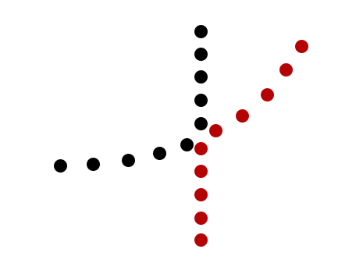
Gestalt Theory
Gestalt Continuity Principle
we tend to group things together
if they are in a smooth directional continuation
proximity
similarity
continuity
curve or color?
symmetry
closure
relative size
figure & ground
Notes:
if they seem to be in a line, we see them as a group

Slide 39

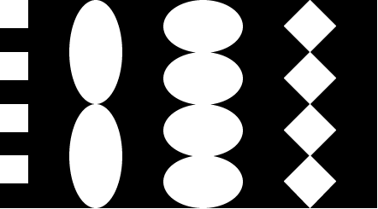
Gestalt Theory
Gestalt Symmetry Principle
we tend to see perceive
symmetrical arrangements
as more likely to be a coherent whole
than parallel arrangements
proximity
similarity
continuity
symmetry
closure
relative size
figure & ground
234
Notes:
if they seem to be in a figure, we see them as a group

Slide 40
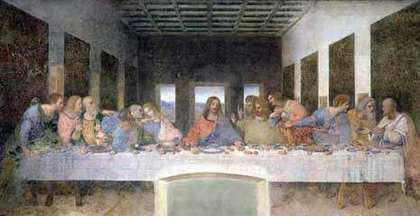
Gestalt Theory
Gestalt Symmetry Principle
we tend to see perceive
symmetrical arrangements
as more likely to be a coherent whole
than parallel arrangements
proximity
similarity
continuity
symmetry
proximity
closure
relative size
figure & ground
234
Notes:
if they seem to be in a figure, we see them as a group

Slide 41
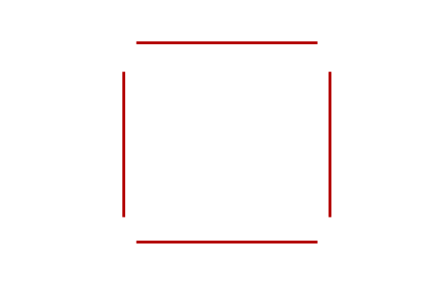
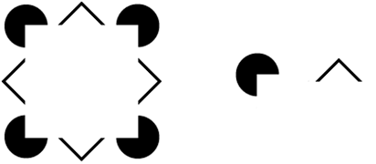
Gestalt Theory
Gestalt Closure Principle
we tend to see a closed contour as an object
there is a perceptual tendency
to close contours
that have gaps in them
proximity
similarity
continuity
symmetry
closure
relative size
figure & ground
44
Notes:
if it looks like it should be a closed line, we tend to close it for ourselves in our minds

Slide 42
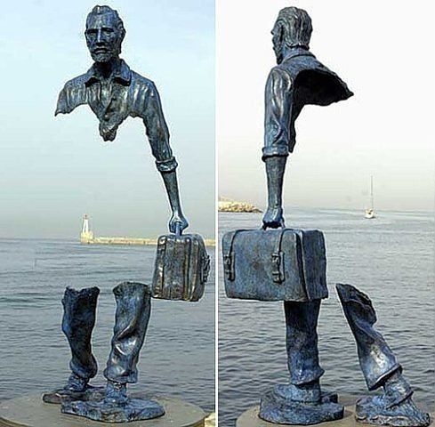
Gestalt Theory
Gestalt Closure Principle
we tend to see a closed contour as an object
there is a perceptual tendency
to close contours
that have gaps in them
proximity
similarity
continuity
symmetry
closure
relative size
figure & ground
44
Notes:
if it looks like it should be a closed line, we tend to close it for ourselves in our minds

Slide 43

Gestalt Theory
Gestalt Closure Principle
we tend to see a closed contour as an object
there is a perceptual tendency
to close contours
that have gaps in them
proximity
similarity
continuity
symmetry
closure
relative size
figure & ground
44
Notes:
if it looks like it should be a closed line, we tend to close it for ourselves in our minds

Slide 44
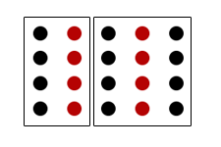
Gestalt Theory
Gestalt Relative Size Principle
we tend to perceive
similar components of a pattern
as objects
we see the similarity
in size and shape
as indicating a relationship among objects
that may not exist
proximity
similarity
continuity
symmetry
closure
relative size
figure & ground
Notes:
if it looks like an object, we tend to assume it is that object

Slide 45
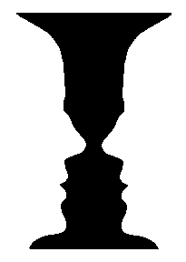
Gestalt Theory
Gestalt Figure & Ground Principle
a fundamental perceptual act of perceiving objects
when confronted by several objects,
we tend to see the figure
that is perceived to be in the foreground
proximity
similarity
continuity
face or candlestick?
symmetry
closure
relative size
figure & ground
96
Notes:
if we must choose, we see the thing in the middle as the object, not the things surrounding it

Slide 46
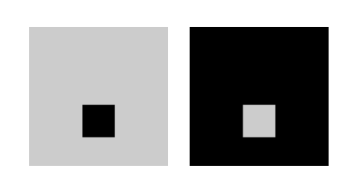
Gestalt Theory
Gestalt Figure & Ground Principle
a fundamental perceptual act of perceiving objects
when confronted by several objects,
we tend to see the figure
that is perceived to be in the foreground
proximity
similarity
continuity
receding or coming forward?
symmetry
closure
relative size
figure & ground
96
Notes:
if we must choose, we see the thing in the middle as the object, not the things surrounding it

Slide 47
Gestalt Theory
Gestalt Figure & Ground Principle
a fundamental perceptual act of perceiving objects
when confronted by several objects,
we tend to see the figure
that is perceived to be in the foreground
you likely see the smaller square as figure in both cases. Its possible in the image on the right you see a dark figure with a hole to a lighter background, which is based on darker objects appearing more often as figure with lighter areas seen as ground.
proximity
similarity
continuity
receding or coming forward?
symmetry
closure
relative size
figure & ground
96
Notes:
if we must choose, we see the thing in the middle as the object, not the things surrounding it

Slide 48
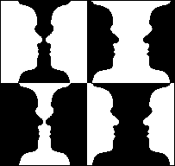
Gestalt Theory
Gestalt Figure & Ground Principle
a fundamental perceptual act of perceiving objects
when confronted by several objects,
we tend to see the figure
that is perceived to be in the foreground
proximity
similarity
continuity
symmetry
closure
relative size
figure & ground
96
Notes:
if we must choose, we see the thing in the middle as the object, not the things surrounding it

Slide 49
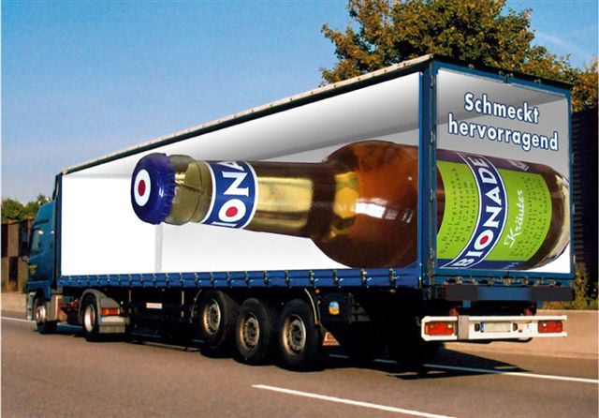
Gestalt Theory
Gestalt Figure & Ground Principle
a fundamental perceptual act of perceiving objects
when confronted by several objects,
we tend to see the figure
that is perceived to be in the foreground
proximity
similarity
continuity
symmetry
closure
relative size
figure & ground
96
Notes:
if we must choose, we see the thing in the middle as the object, not the things surrounding it

Slide 50
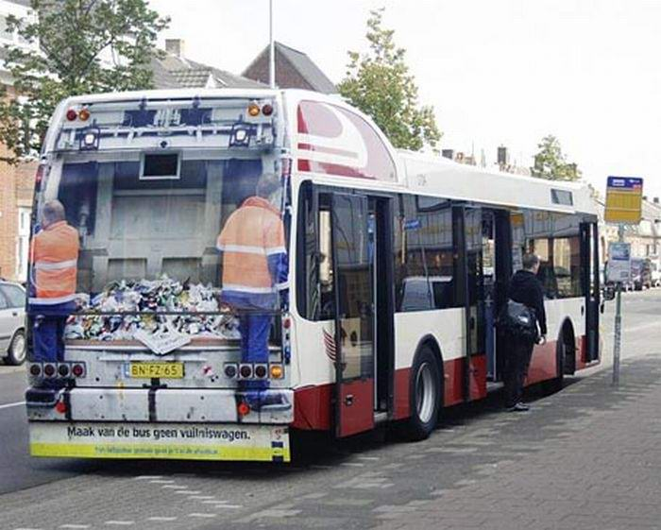
Gestalt Theory
Gestalt Figure & Ground Principle
a fundamental perceptual act of perceiving objects
when confronted by several objects,
we tend to see the figure
that is perceived to be in the foreground
proximity
similarity
continuity
symmetry
closure
relative size
figure & ground
96
Notes:
if we must choose, we see the thing in the middle as the object, not the things surrounding it

Slide 51
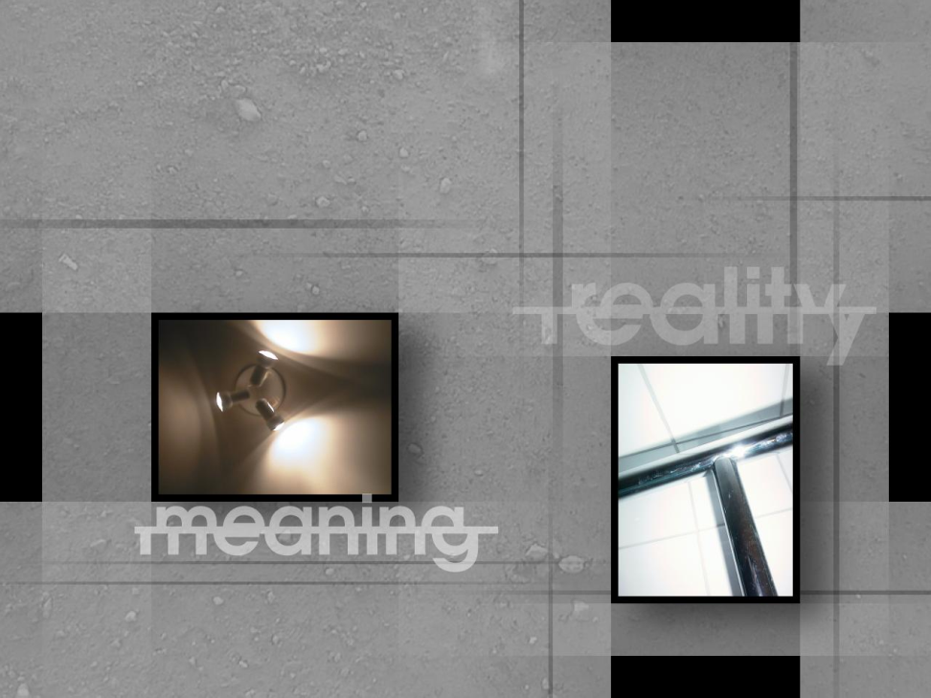
We seem as a species to be driven by a desire to make meanings
bottom-up
or top-down understanding?
above all, we are surely
Homo significans (meaning-makers)
Notes:
There’s a fundamental difference of opinion about how we understand what we see, though both arguments seem to have validity and the validity of one does not seem to undermine the validity of the other. It may well be that we understand in both manners.
Semiotics, Ware, pp. 5-22.
Affordances, Ware, pp. 22-25.
The link from Bertin is to a set of hidden slides.

Slide 52
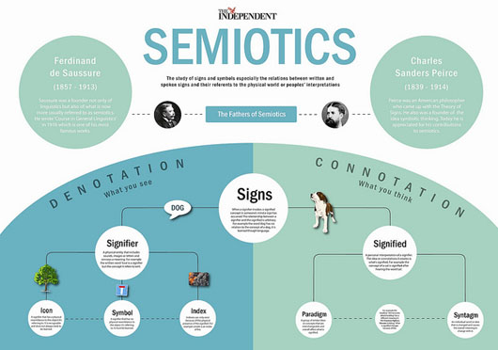
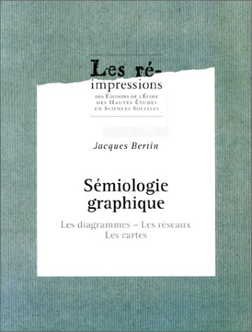

So, which is it?
bottom-up
arbitrary symbols
Notes:
There’s a fundamental difference of opinion about how we understand what we see, though both arguments seem to have validity and the validity of one does not seem to undermine the validity of the other. It may well be that we understand in both manners.
Semiotics, Ware, pp. 5-22.
Affordances, Ware, pp. 22-25.
The link from Bertin is to a set of hidden slides.

Slide 53
So, which is it?
bottom-up
arbitrary symbols
Semiology
builds on symbols (or signs)
and how they convey meaning
  signs have no intrinsic meaning
  become signs only when we invest them with meaning.
anything can be a sign
as long as someone interprets it
as referring to something
other than itself.
Notes:
There’s a fundamental difference of opinion about how we understand what we see, though both arguments seem to have validity and the validity of one does not seem to undermine the validity of the other. It may well be that we understand in both manners.
Semiotics, Ware, pp. 5-22.
Affordances, Ware, pp. 22-25.
The link from Bertin is to a set of hidden slides.

Slide 54
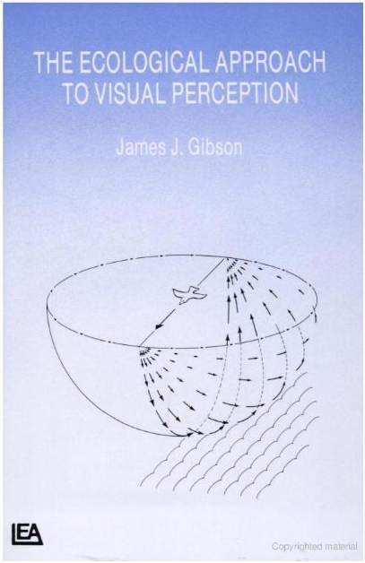
So, which is it?
bottom-up
or top-down understanding?
Sensory symbols
Affordances
  top-down approach
  builds on perceiving possibilities for action in the affordances we perceive through our sense of sight.
Notes:
There’s a fundamental difference of opinion about how we understand what we see, though both arguments seem to have validity and the validity of one does not seem to undermine the validity of the other. It may well be that we understand in both manners.
Semiotics, Ware, pp. 5-22.
Affordances, Ware, pp. 22-25.
The link from Bertin is to a set of hidden slides.

Slide 55
Next time
logic

