Slide 1
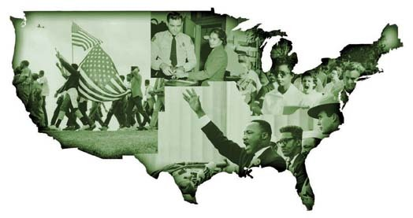
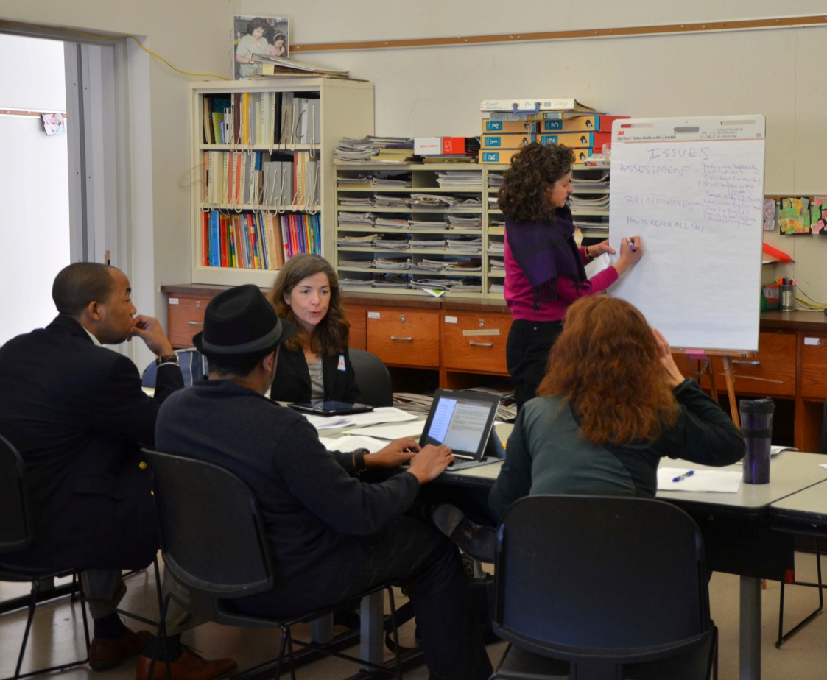
Lift Every Voice:
Preserving and Teaching Civil Rights History
Celeste Â-Re, Cultural Heritage Informatics Fellow
welch4@email.sc.edu
Introduction
Marchers © Takestock/Matt Herron; Policeman and Rosa Parks © AP Photo/
Gene Herrick Students at Little Rock’s Central High School ©
CORBIS/Bettmann; Dr. King’s speech © CORBIS/Bob Adelman
Southern Poverty Law
Center’s (SPLC) Teaching
the Movement: The State of
Civil Rights Education in the
United States, concluded
that Civil Rights history is
not being effectively taught;
recommending that
knowledge bases, materials
and models of best practice must be
identified and created.
Proposed Project
Stakeholder communities in South
Carolina have joined with SPLC and the Roy Rosenzweig Center for
History and New Media, to launch
the Lift Every Voice project, a
national initiative aimed at
identifying digital curators, archivists
and librarians to assess Civil Rights
holdings, and collect oral histories of
surviving Civil Rights activists.
Minuette Floyd, photographer
Objectives
Develop guidelines, model
and network for collecting and preserving Civil Rights
artifacts.
Develop digital collections and web-based Civil Rights history archive.
.

